Slide 1

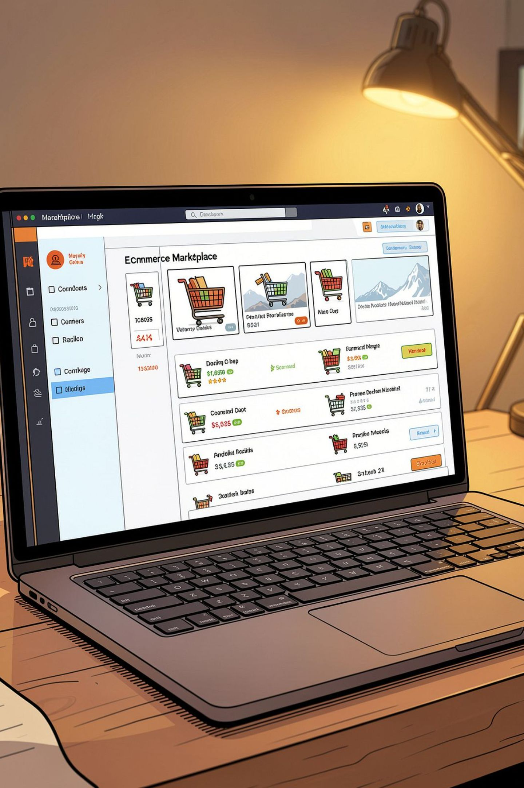
Multi‑Vendor E‑Commerce Marketplace
A unified web platform that connects independent vendors with customers, streamlines product management, and centralizes order processing.
Batch No: 11
K. Sriram (2520090022)
Haricharansai (2520090048)
Hasith Varma (2520090125)
Review- 2
DBMS

Slide 2

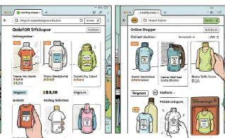

Problem & Motivation
Limited Reach for Small Sellers
Fragmented Customer Experience
Inefficient Management
Independent vendors struggle to find customers and scale without a central marketplace.
Vendors lack simple, centralized tools to manage stock, orders, and product updates.
Customers must visit multiple sites to compare products, prices, and reviews — slowing decisions.
A single platform reduces friction: centralized discovery, unified product data, and shared trust signals like ratings and reviews.

Slide 3
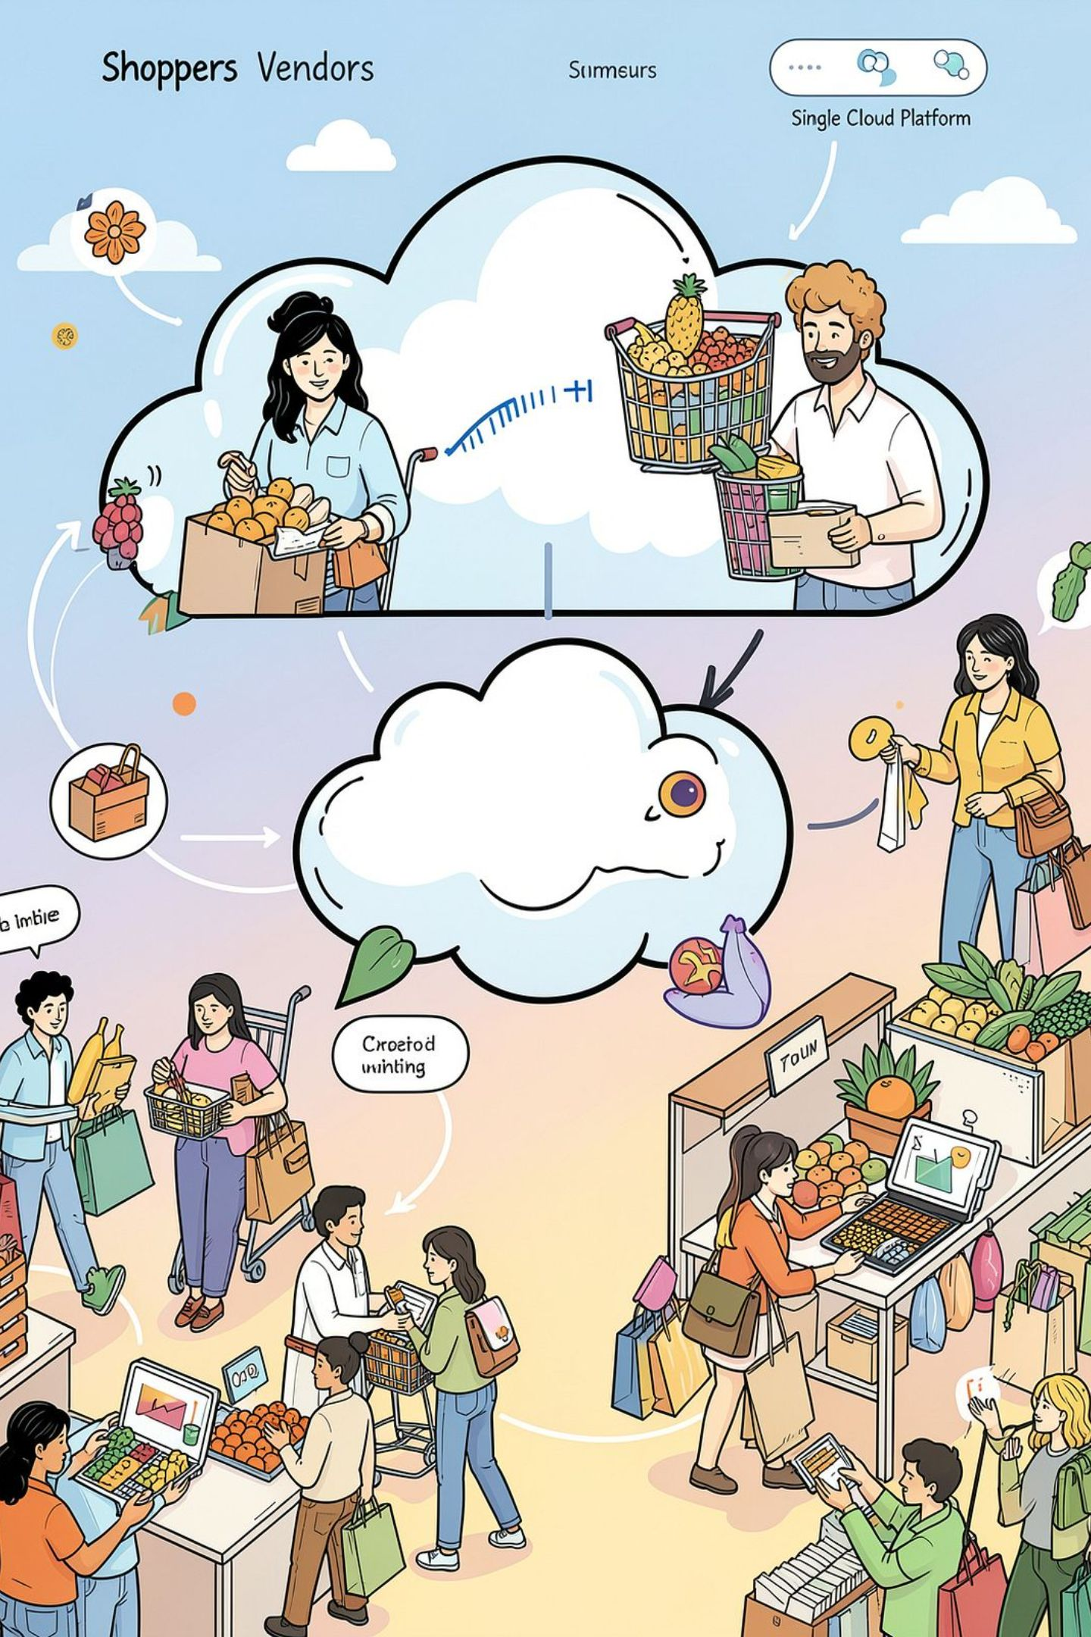
Abstract
The proposed Multi‑Vendor E‑Commerce Marketplace is a responsive web application that enables multiple sellers to list and manage products while providing customers with unified search, comparison, purchasing, and tracking workflows. Core features include vendor registration and product management, customer accounts and carts, order lifecycle tracking, and an administrator console to oversee users, vendors, products, and transactions.
By aggregating sellers and product catalogs, the system aims to increase vendor visibility, simplify customer decision‑making, and provide scalable operations suitable for academic evaluation and real‑world deployment.

Slide 4
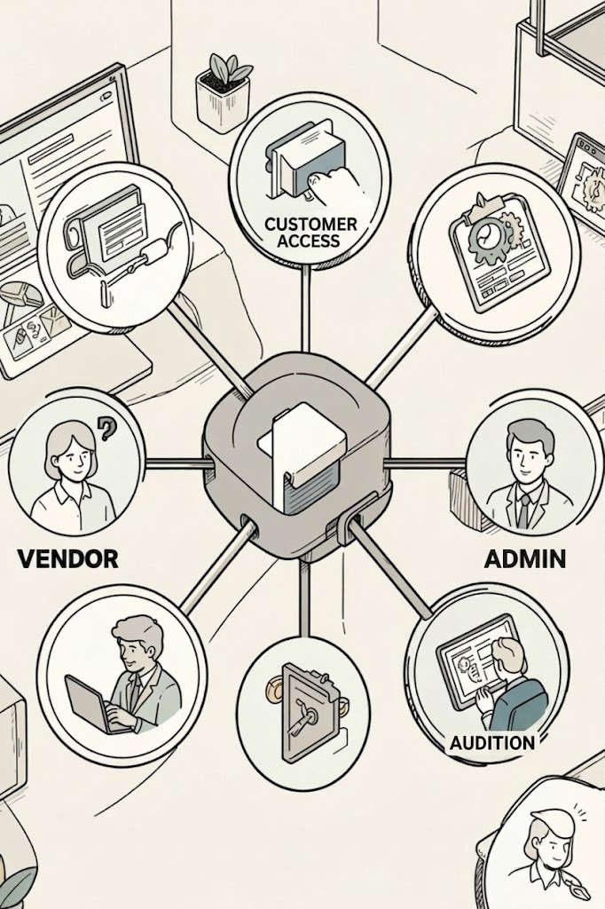

Proposed Solution — Role-Based Features
Architectural Overview
1
A single codebase exposes RESTful APIs with role‑based authorization. Roles: Vendor, Customer, Admin. Each role has tailored UI views and specific CRUD privileges to preserve data integrity and traceability.
Vendor
Register, add & edit products, manage stock, view orders and fulfillment status.
Use JWT for session authorization and bcrypt for secure password storage.
2
Customer
Browse & search catalogs, compare items, cart & checkout, track orders, rate products.
3
Admin
Manage users, onboard vendors, moderate products & reviews, monitor orders and reports.

Slide 5





Technology Stack
Frontend
Backend
Database
Authentication & Security
React.js • Bootstrap • CSS • Axios • React Router — responsive, componentized UI
Node.js • Express.js — REST APIs, authentication, and business logic
MongoDB with MongoDB Compass for schema exploration and flexible document models
JWT tokens for stateless auth, bcrypt.js for password hashing, role checks on every endpoint
Development Tools
VS Code • Git • GitHub — version control, issue tracking, and CI/CD readiness

Slide 6

Expected Outcome
For Customers
For Vendors
Unified product discovery, seamless checkout flow, order tracking, and aggregated reviews facilitate faster, more informed purchases.
Simple onboarding, SKU and stock management, order visibility, and consolidated sales reports increase reach and operational efficiency.
For Admins & Instructors
Centralized control over users, vendors, and content; instrumentation for auditing, grading, and demonstration of DBMS concepts like schema design, indexing, and transaction handling.
Overall objective: deliver a robust, well‑documented DBMS project that demonstrates practical application of web technologies, secure authentication, role‑based access, and scalable data models.
Next steps: implement full API test suite, add payment gateway integration, and prepare demo data for evaluation.

Slide 7

SYSTEM ARCHITECTURE
USERS
FRONTEND
Rest
API
BACKEND
Customer
Vendor
Admin
React + Vite
Search
Cart
Checkout
Node + Express
Auth + RBAC
MongoDB
DATABASE LAYER
Users
Products
Vendors
Orders
Reviews
Categories
CRUD
Queries
Filtering
Indexing

Slide 8
Conclusion
The Multi-Vendor E-Commerce Marketplace provides a single platform where customers can discover, compare, and purchase products from multiple vendors. It simplifies the shopping process by bringing products, prices, ratings, and reviews together in one place, while helping vendors reach more customers and manage their products and orders efficiently.

